Slide 1


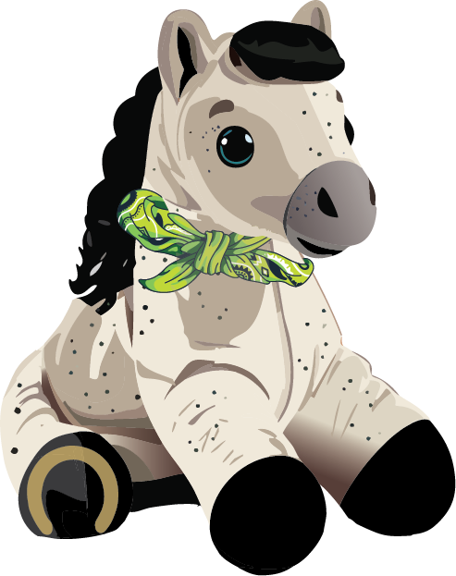
Learn How to Respond Effectively to Mental Health Challenges

Slide 2

The Green Bandana Mascot
HELLO my name is
RACER1
2

Slide 3
What Is the Green Bandana Project?
The goal of the project is to increase awareness of mental health and help students feel comfortable reaching out when they see someone struggling
Sometimes all a person needs is to know that someone cares and is willing to listen and support them
Other times, they need another person to help them get connected with additional resources on campus
3

Slide 4
Mental Health and Higher Education
The campus environment can impact mental health, due to stressors such as being away from home, studying for tests, and paying for school.
Students on campus also have access to more resources that can help them manage their mental health.
We can all play a role in improving our campus environment as it relates to mental health.
4

Slide 5
Role of a Green Bandana Ambassador
Observe changes in behaviors
Offer a nonjudgmental listening ear
Respect the individual’s culture
Help them get connected with resources
Decrease stigma about mental health
Do not try to diagnose or treat yourself or others
5

Slide 6
How Do We Define Mental Health?
Mental health is a state of wellbeing in which the individual
Realizes their own abilities
Can cope with the normal stresses of life
Can work productively and fruitfully
Can contribute to their community
Can participate in activities they enjoy
Feels content and satisfied with their life
6

Slide 7
What Is a Mental Health Challenge?
A major change in a person’s thinking, feeling, or behaviors
The change interferes with the person’s ability to live their life as they would like to
The interference lasts longer than typical emotions or reactions might be expected to last
This frequently causes significant distress
7

Slide 8
Factors That Affect Mental Health
CULTURAL
SOCIAL
FAMILIAL
PSYCHOLOGICAL
BIOLOGICAL
8

Slide 9
How Common Are Mental Health Disorders?
Approximately 1 in 5 adults in the U.S. are diagnosed with a mental health disorder in a typical year.
Almost half of all adults in the U.S. will experience a mental health challenge at some point during their lifetime.
9

Slide 10
Gaps in Treatment
Many people with mental health challenges choose not to seek professional help.
One study found that more than 40% of people with diagnosable disorders sought no treatment in the year prior to the study.
Perceived public stigma refers to people’s beliefs about whether others in their culture hold stigmatizing views.
10

Slide 11

Common Barriers to Seeking Help
Students don’t know counseling is available on campus
Students don’t know it’s free
Students don’t think they have time for counseling
Students don’t want people to think they are weak
11

Slide 12
The Importance of Early Intervention
Early intervention can help prevent symptoms from becoming more serious and can reduce the risk of secondary effects, such as
School failure or job loss
Relationship difficulties
Arrests or problems with the law
Struggles with drugs and alcohol
12

Slide 13
Delayed Treatment Worsens Outcomes
Many people have a long delay between developing a mental health challenge and receiving appropriate treatment and support.
The longer the delay, the more difficult recovery can be.
It is important for people to get support from family, friends, peers, and colleagues during this time.
People are more likely to seek help if someone they know and trust suggests it.
13

Slide 14
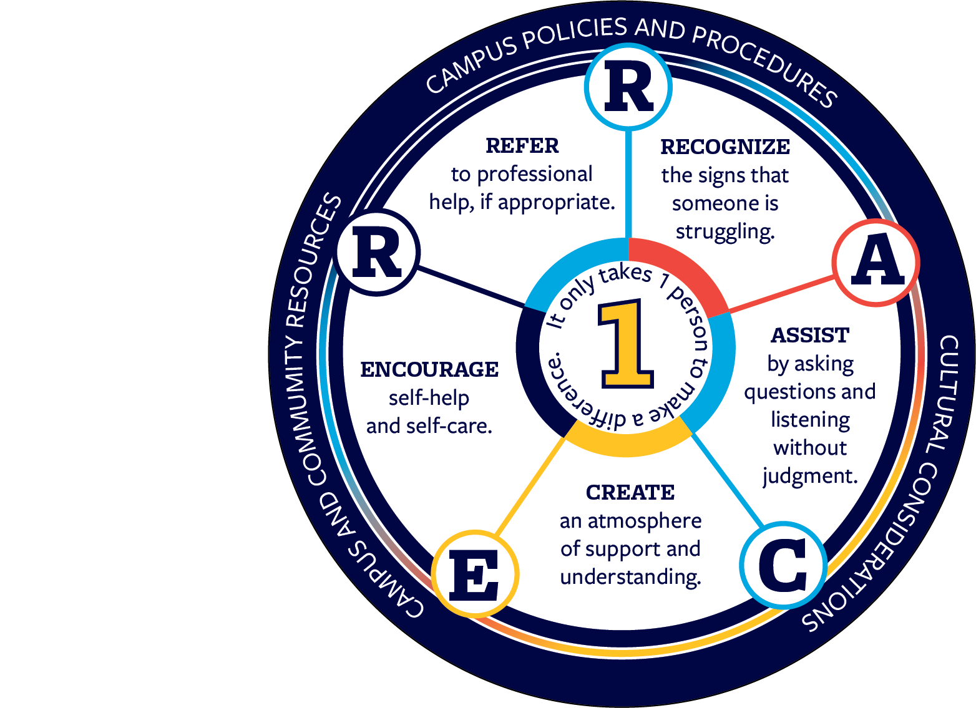
The Green Bandana Action Plan
14

Slide 15
Action Step R: Recognize the signs that someone is struggling
Signs are things we can see or observe that indicate a possible mental health challenge
Symptoms are indicators of a mental health challenge that a person can feel but may not be observable
Green Bandana Ambassadors observe changes in a person’s behaviors, appearance, feelings, and thoughts
15

Slide 16
What Does an Ambassador Notice?
If there is a major change or a new pattern in a person’s thinking, feeling, appearance, or behaviors
If the change interferes with the person’s ability to live their life as they previously did
If the interference does not go away quickly and lasts longer than typical emotions or reactions might be expected to last
16

Slide 17
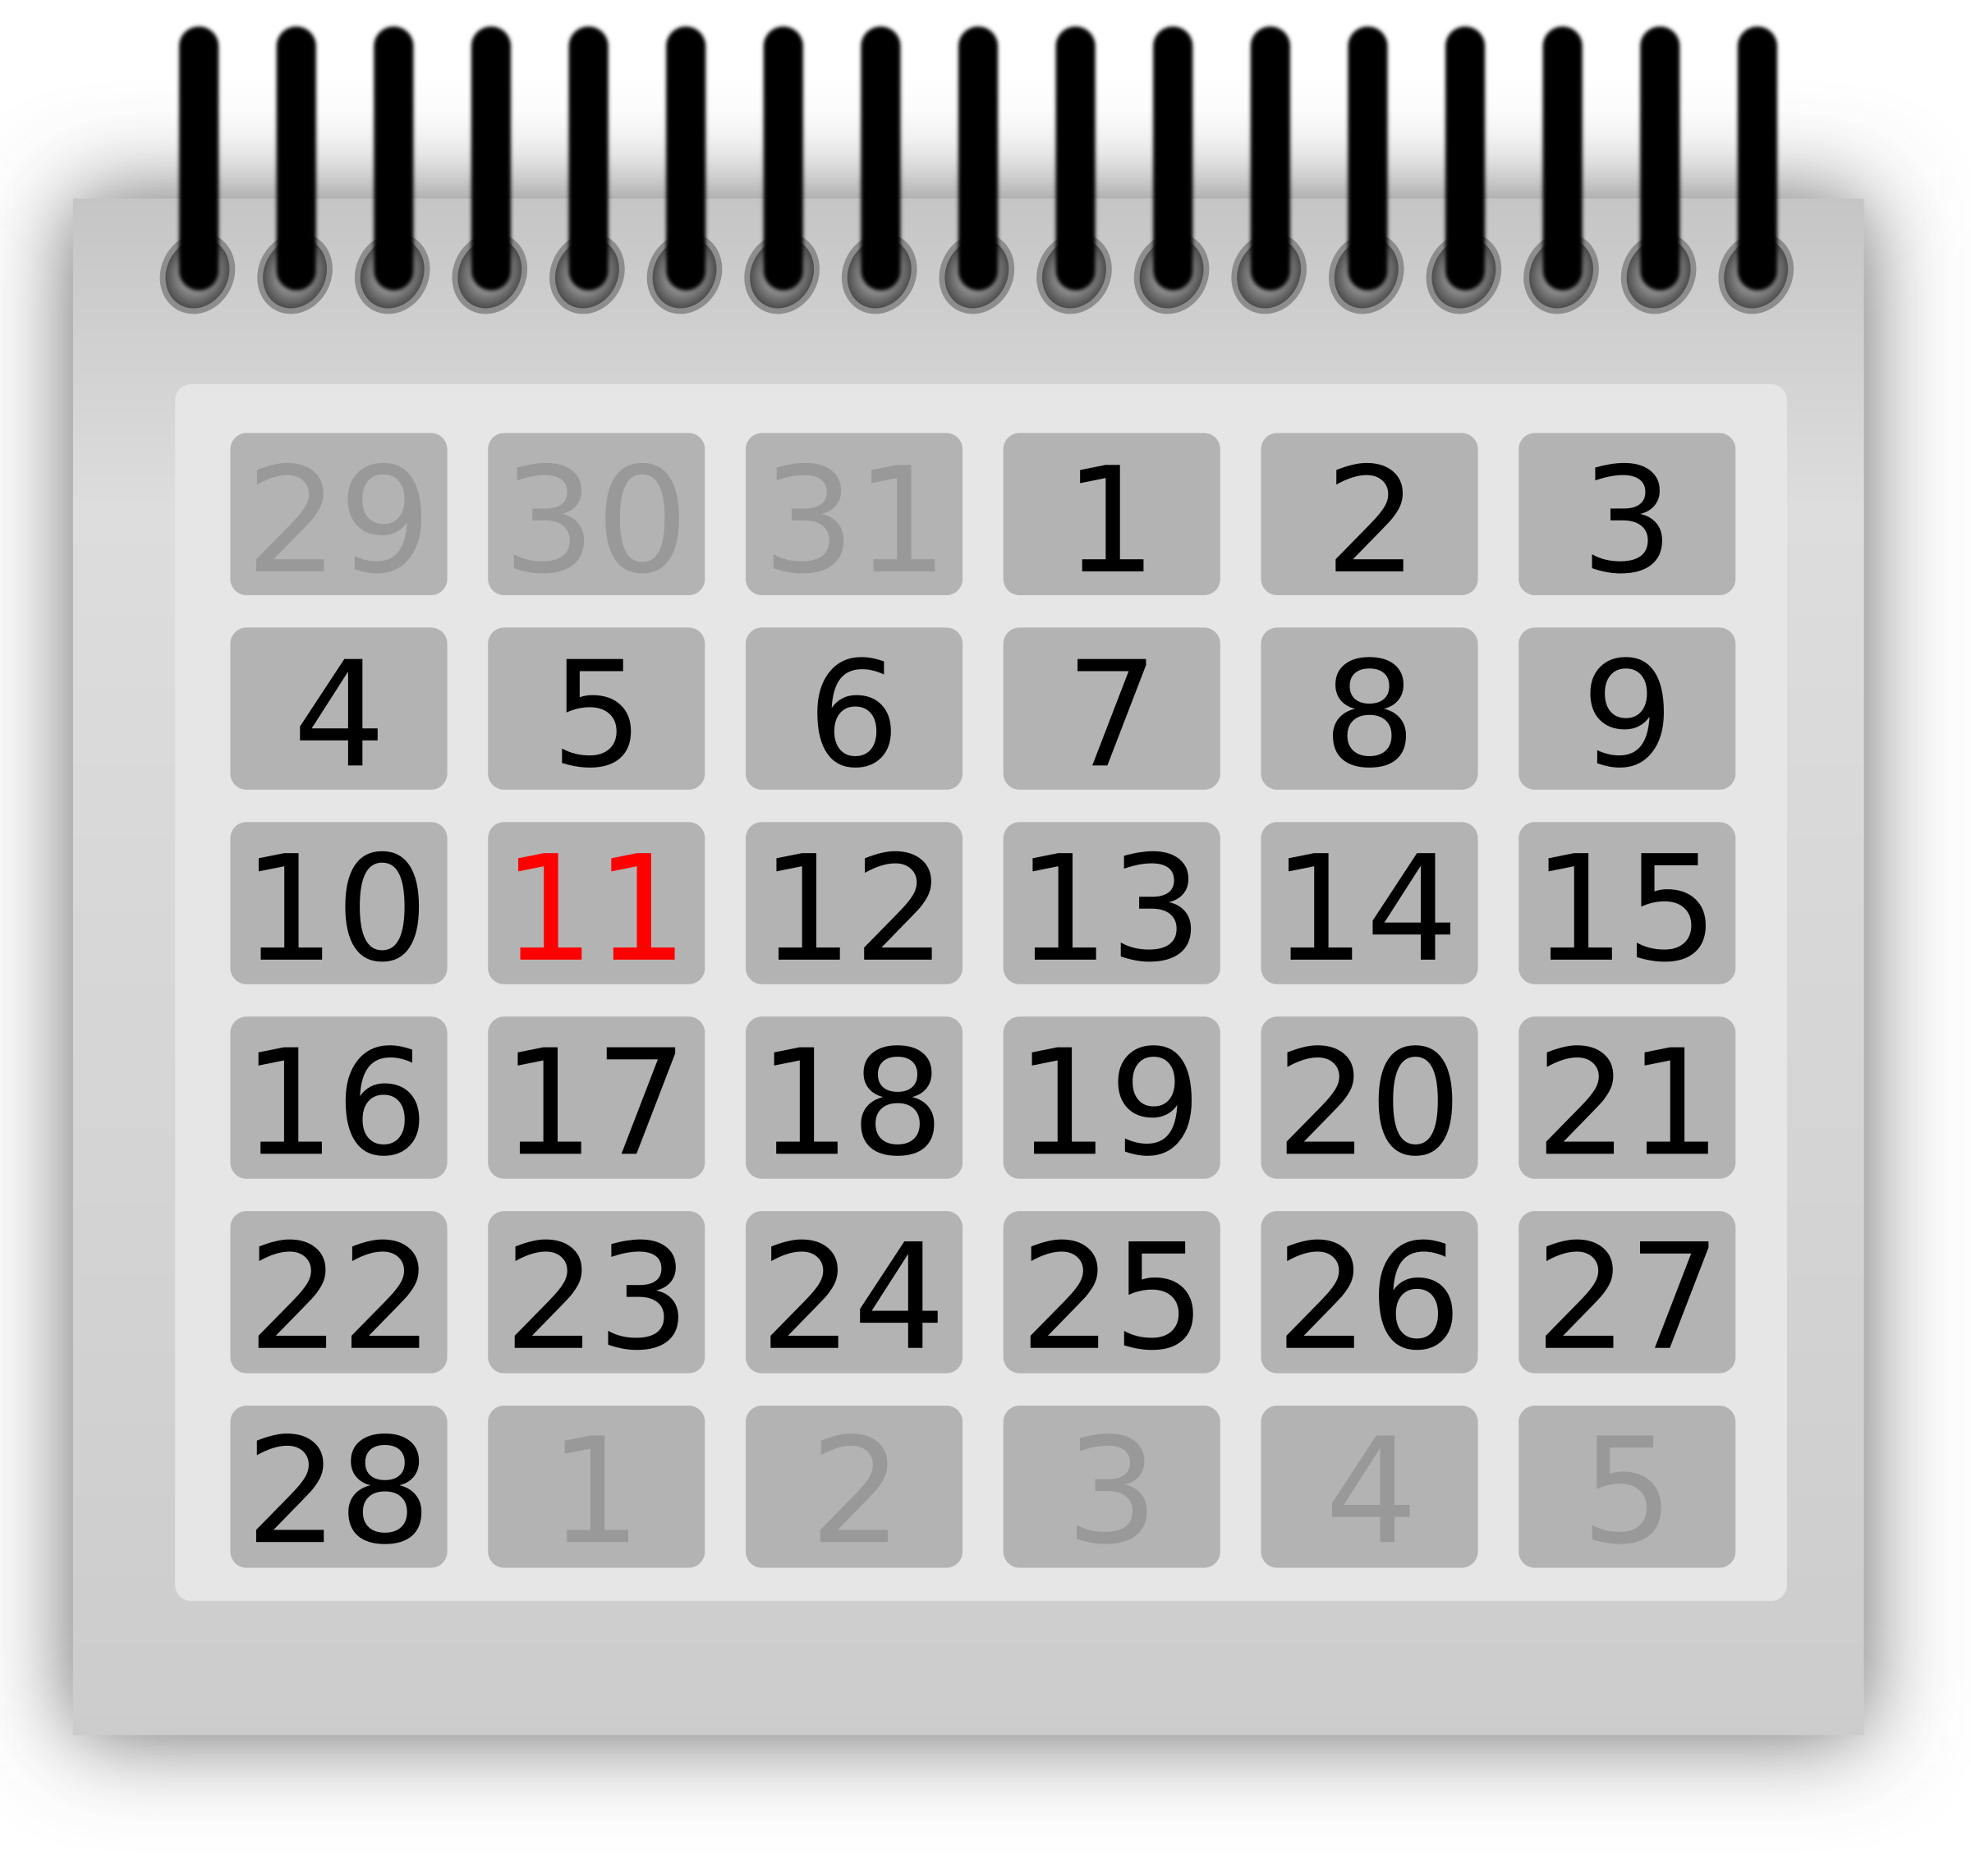


Pay Attention to Signs and Symptoms
FREQUENCY
Signs and symptoms are experienced many times per day or most days.
DURATION
Signs and symptoms have been present for a period of time, or new patterns have developed.
IMPACT
Signs and symptoms interfere with work or school performance, relationships, or participation in usual activities.
17

Slide 18

Action Step A: Assist by asking questions and listening without judgment
Effective nonjudgmental listeners pay special attention to two important areas:
Verbal cues and how they are conveyed
Nonverbal cues and how they are conveyed
18

Slide 19
How to Approach and Assist
Use “I” statements: “I have noticed” or “I am worried”
Ask clarifying questions as needed so that you can understand their situation and be more helpful
Be aware that a person may not open up to you right away or may downplay their situation
Do not pressure them to talk right away. Let them know you are available when they are ready to talk.
19

Slide 20
Action Step C: Create an atmosphere of support and understanding
Provide reassurance and information, not advice:
Reassurance is a statement, comment, or action that helps relieve a person’s fears
Information helps a person understand a concept, consider options and next steps, and indicate whether they feel that they need additional help or support
Advice is telling someone what you think they should do
20

Slide 21
Action Step E: Encourage self-help and self-care
Self-help is when an individual uses their own efforts and resources to cope with challenges.
Self-care is when an individual makes a conscious effort to take care of themselves and participate in activities that they enjoy and are good for their health.
Not everyone is ready or willing to try self-help, and some people don’t believe they deserve self-care.
21

Slide 22
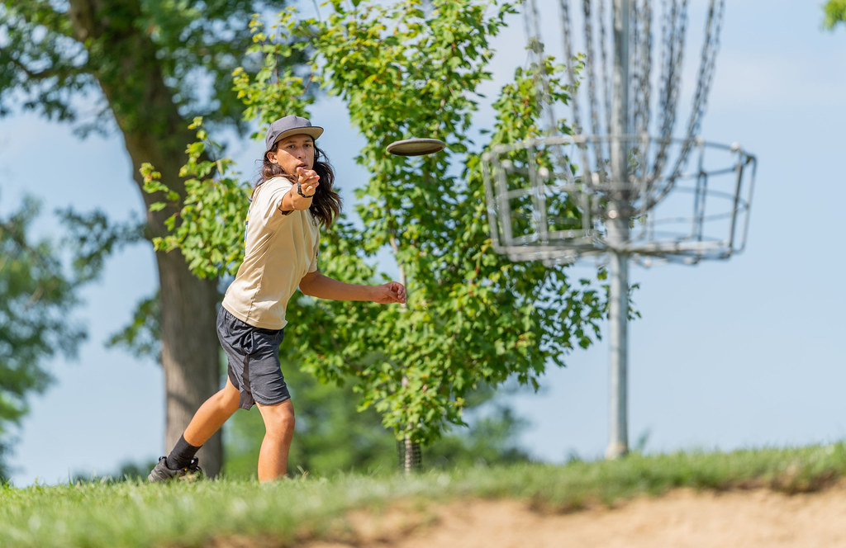

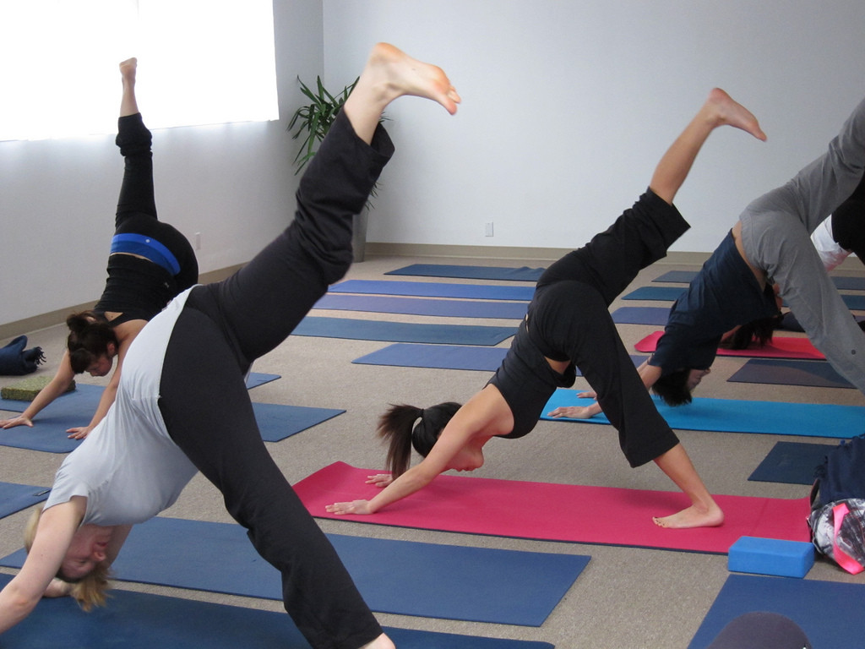

Self-Help and Self-Care Strategies
Exercise
Meditation
Peer support groups
Self-help books
Social networks
Hobbies
Creative activities
22

Slide 23

Action Step R: Refer to professional help, if appropriate
Medical doctors
Advanced practitioners
Psychologists, counselors, and therapists
Social workers
Crisis support specialists
Substance abuse professionals
Certified peer specialists
MEDICAL DOCTORS
ADVANCED
PRACTITIONERS
SOCIAL WORKERS
PSYCHOLOGISTS
COUNSELORS
AND THERAPISTS
CRISIS SUPPORT
SPECIALISTS
SUBSTANCE USE
PROFESSIONALS
CERTIFIED PEER
SPECIALISTS
23

Slide 24
Mental Health Resources at Murray State
The university currently offers 3 options that provide free counseling for students. All 3 places offer both ongoing scheduled sessions and on-demand sessions:
University Counseling Center: C104 Applied Science
Psychological Center: 401 Wells Hall
TimelyCare: Virtual only, can access from all 50 states
24
Notes:
Bring handouts with more information!

Slide 25
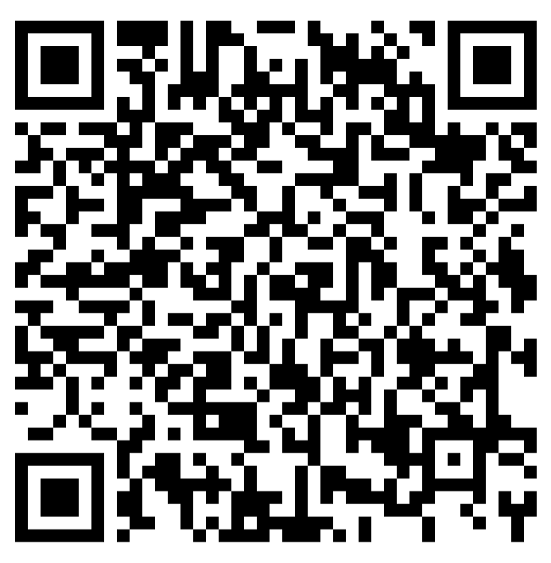
Additional Resources at Murray State
Center for Student Engagement and Success
Health Services
Student Disability Services
Oakley Resource Center (formerly the Women’s Center)
Oakley Student Lounge (formerly the Pride Center)
Tutoring and Academic Advising
Racers Helping Racers Food Pantry
SEAL Office
25

Slide 26
Action Step 1: One person can make a difference
See Something: Recognize the signs
Say Something: Approach the individual and express your concern and support
Do Something: If needed, help the individual connect to the appropriate resources
That individual now knows there is at least one person on campus who cares about them and is willing to help them.
26

Slide 27
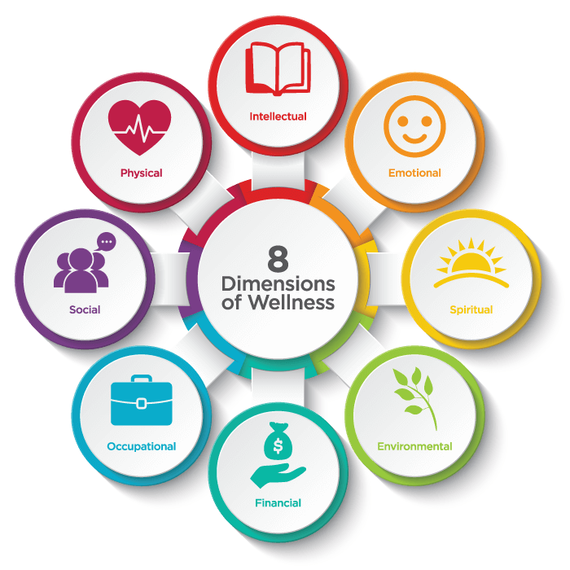
Self-Care and the Dimensions of Wellness
27

Slide 28
Your Homework
Practice being a nonjudgmental listener and a supportive friend with your current friends.
Consider reaching out to potential future friends and practice being a nonjudgmental listener and a supportive friend to them.
Remember to be your own friend. Practice being a nonjudgmental listener and a supportive friend to yourself. Give yourself compliments, too!
28

Slide 29

CONGRATULATIONS!
You are now a GREEN BANDANA AMBASSADOR!
Wear your Green Bandana with pride!
Be that 1 person who makes a difference!

Slide 30

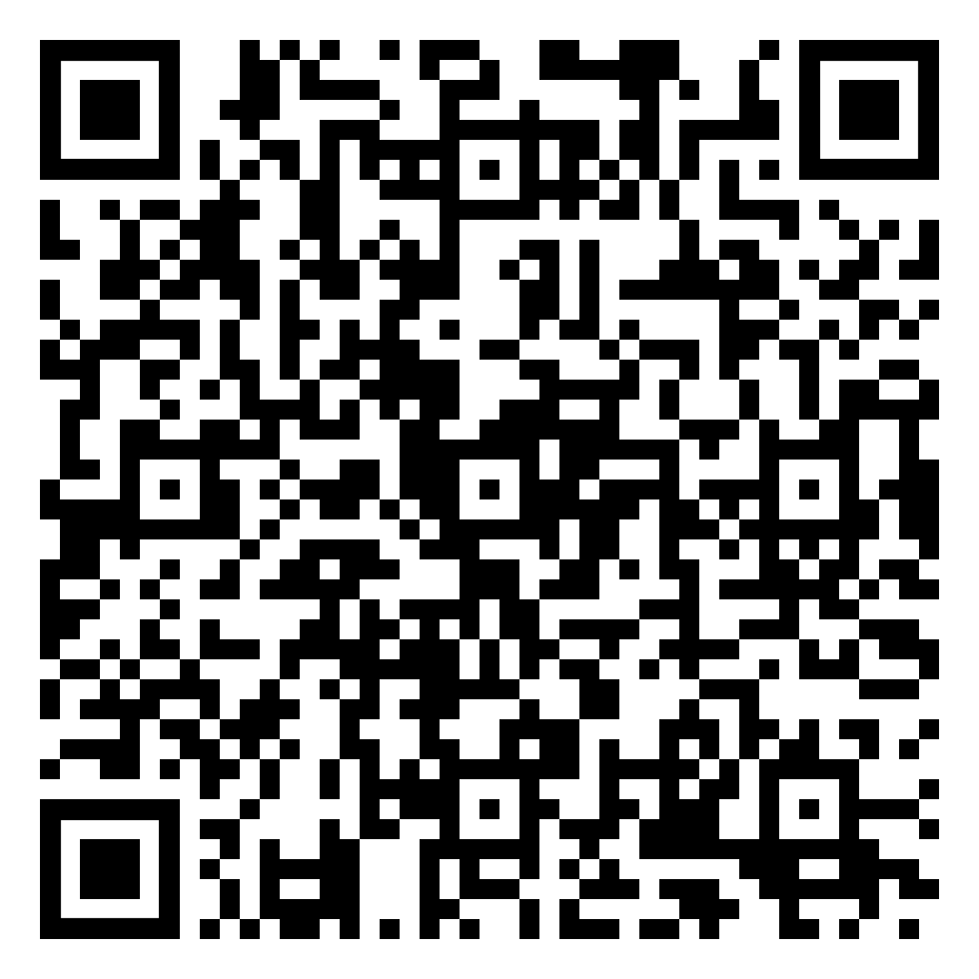
Please sign in using the QR code.
After the presentation, we will send you a feedback survey so you can let us know what you thought of the presentation.
Everyone who signs in will also be entered into a lottery to win your very own Racer1 stuffed animal wearing a green bandana!

